Slide 1

Intelligent Agents
Artificial Intelligence
Instructor: M Zeeshan Aslam
Email: zeeshan.aslam@case.edu.pk

Slide 2
Outlines
What is Agent?
PEAS Description.
Types of Agents.

Slide 3
What is an Agent?
An agent can be anything that perceive its environment through sensors and act upon that environment through actuators. An Agent runs in the cycle of perceiving, thinking, and acting.
An agent can be:
Human-Agent: A human agent has eyes, ears, and other organs which work for sensors and hand, legs, vocal tract work for actuators.
Robotic Agent: A robotic agent can have cameras, infrared range finder, NLP for sensors and various motors for actuators.
Software Agent: Software agent can have keystrokes, file contents as sensory input and act on those inputs and display output on the screen.
Hence the world around us is full of agents such as thermostat, cellphone, camera, and even we are also agents.
Notes:
How we can built intelligent agent? Agent sense/percept from environment. Current + Historical Percept

Slide 4
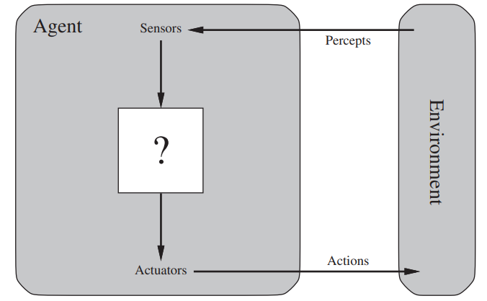
Agents and Environments

Slide 5
Agents and Environments
Sensor: Sensor is a device which detects the change in the environment and sends the information to other electronic devices. An agent observes its environment through sensors.
Actuators: Actuators are the component of machines that converts energy into motion. The actuators are only responsible for moving and controlling a system. An actuator can be an electric motor, gears, rails, etc.
Effectors: Effectors are the devices which affect the environment. Effectors can be legs, wheels, arms, fingers, wings, fins, and display screen.

Slide 6
What we want to achieve from Agents
High performance
Optimized results
Rational Action (Right Action)

Slide 7
Specifying the Task Environment
If we want to make a simple vacuum-cleaner agent, we had to specify the performance measure, the environment, and the agent’s actuators and sensors. We group all these under the heading of the task environment. we call PEAS this the PEAS (Performance, Environment, Actuators, Sensors) description.
In designing an agent, the first step must always be to specify the task environment as fully as possible.

Slide 8
Examples of agent types and their PEAS descriptions.
Agent Type | Performance Measure | Environment | Actuators | Sensors
Medical diagnosis system | Healthy patient, reduced costs | Patient, hospital, staff | Display of questions, tests, diagnoses, treatments, referrals | Keyboard entry of symptoms, findings, patient’s answers
Interactive English tutor | Student’s score on test | Set of students, testing agency | Display of exercises, suggestions, corrections | Keyboard entry
Satellite image analysis system | Correct image categorization | Downlink from orbiting satellite | Display of scene categorization | Color pixel arrays

Slide 9
Task
Agent Type | Performance Measure | Environment | Actuators | Sensors
Cab Driver
Part-picking robot
Safe, fast, legal, comfortable trip, maximize profits
Roads, other traffic, pedestrians, customers
Steering, accelerator, brake, signal, horn, display
Cameras, sonar, speedometer, GPS, odometer, accelerometer, engine sensors, keyboard
Percentage of parts in correct bins
Conveyor belt with parts; bins
Jointed arm and hand
Camera, joint angle sensors

Slide 10
Types of AI Agents
Agents can be grouped into four classes based on their degree of perceived intelligence and capability. All these agents can improve their performance and generate better action over the time.
These are given below:
Simple Reflex Agent
Model-based reflex agent
Goal-based agents
Utility-based agent

Slide 11
Simple Reflex Agent
The Simple reflex agents are the simplest agents. These agents take decisions on the basis of the current percepts and ignore the rest of the percept history.
These agents only succeed in the fully observable environment.
The Simple reflex agent does not consider any part of percepts history during their decision and action process.
The Simple reflex agent works on Condition-action rule, which means it maps the current state to action.
Notes:
Reflex means immediate, spontaneous.

Slide 12
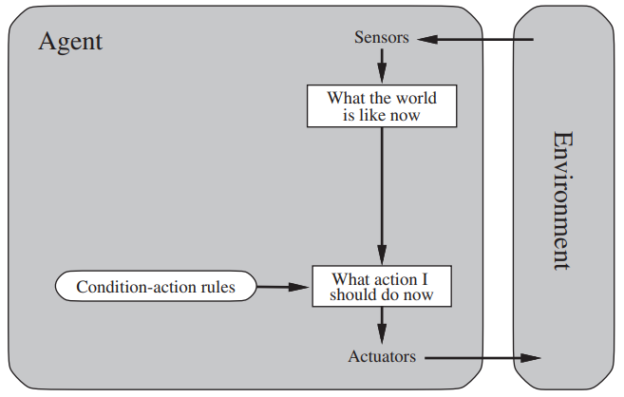
Simple Reflex Agent

Slide 13
Problems of Simple Reflex agent
They have very limited intelligence
They do not have knowledge of non-perceptual parts of the current state
Mostly too big to generate and to store.
Not adaptive to changes in the environment.

Slide 14
Task
Write Pseudo-code for the vacuum cleaner a simple reflex agent.
function simple_reflex_vacuum_agent(percept):
if percept == "dirty":
action = "clean"
elif percept == "clean":
action = "move"
else:
action = "do_nothing"
return action

Slide 15
Model-Based Reflex Agent
The Model-based agent can work in a partially observable environment, and track the situation.
A model-based agent has two important factors:
Model: It is knowledge about "how things happen in the world," so it is called a Model-based agent.
Internal State: It is a representation of the current state based on percept history.
These agents have the model, "which is knowledge of the world" and based on the model they perform actions.
Updating the agent state requires information about:
How the world evolves
How the agent's action affects the world.

Slide 16
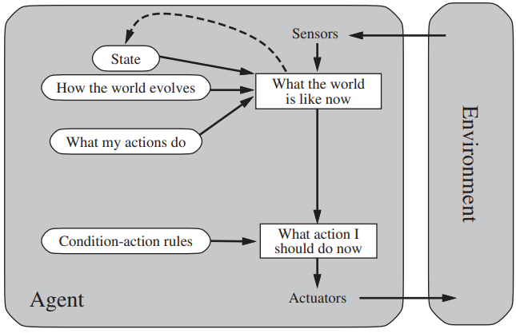
Model-Based Reflex Agent

Slide 17
Goal-Based Agents
The knowledge of the current state environment is not always sufficient to decide for an agent to what to do.
The agent needs to know its goal which describes desirable situations.
Goal-based agents expand the capabilities of the model-based agent by having the "goal" information.
They choose an action, so that they can achieve the goal.
These agents may have to consider a long sequence of possible actions before deciding whether the goal is achieved or not. Such considerations of different scenario are called searching and planning, which makes an agent proactive.

Slide 18
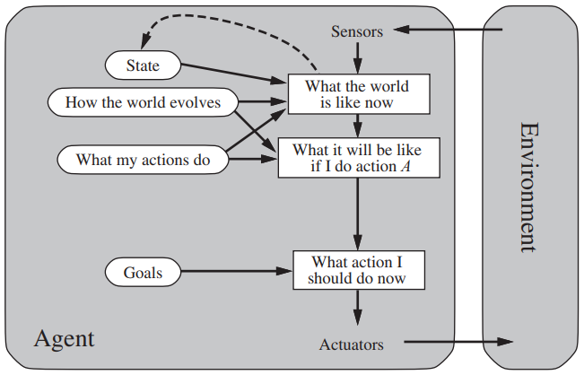
Goal-Based Agents

Slide 19
Utility-Based Agents
These agents are similar to the goal-based agent but provide an extra component of utility measurement which makes them different by providing a measure of success at a given state.
Utility-based agent act based not only goals but also the best way to achieve the goal.
The Utility-based agent is useful when there are multiple possible alternatives, and an agent has to choose in order to perform the best action.
The utility function maps each state to a real number to check how efficiently each action achieves the goals.

Slide 20
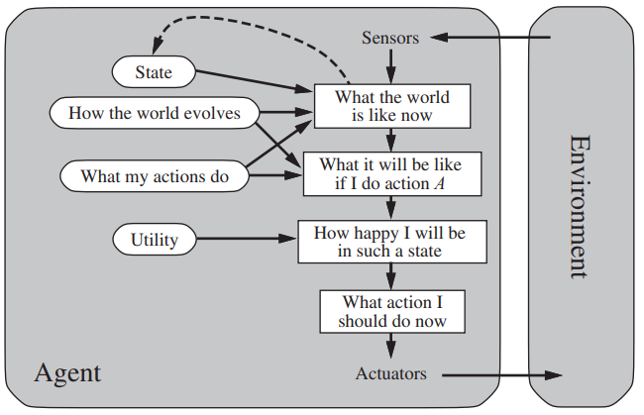
Utility-Based Agents

